Slide 1
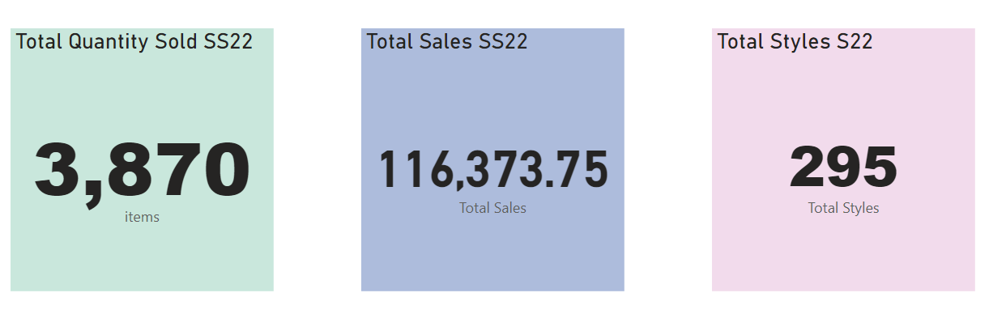
SS22 GENERAL OUTLOOK

Slide 2
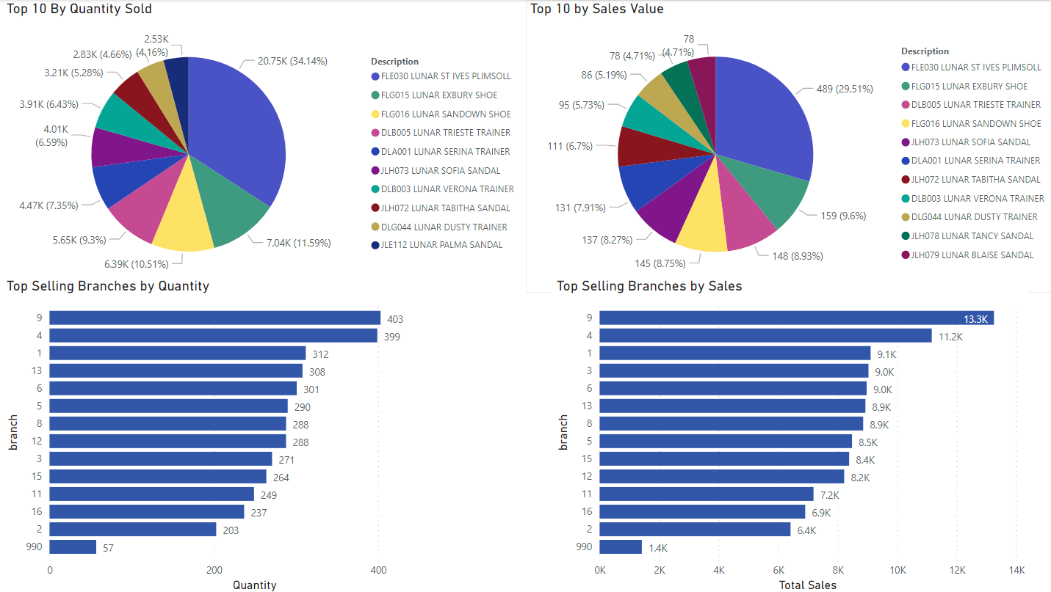

Slide 3
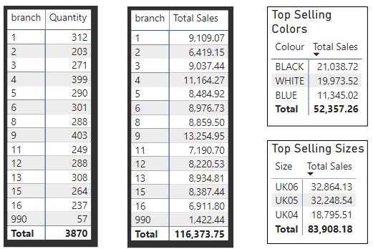
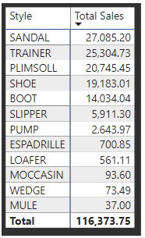
Some extra info

Slide 4
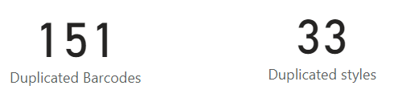
Some barcodes have been duplicated.
Some items can’t be accurate because it’s impossible to know to which of the items the barcodes referred to.

